Slide 1
HRGP data feature selection
Maxwell Mullin

Slide 2
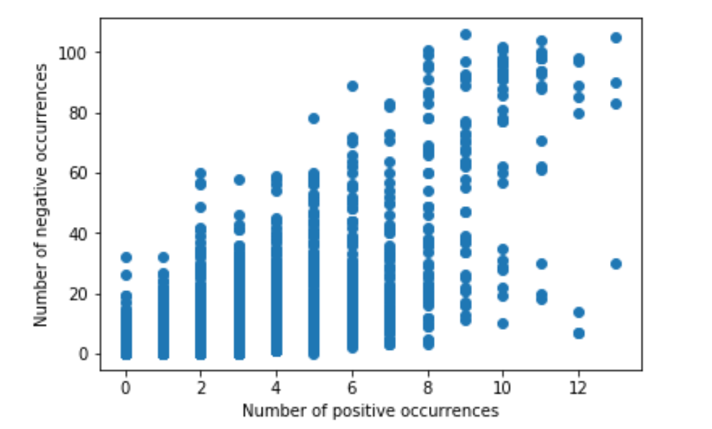
motif foreground vs background counts

Slide 3
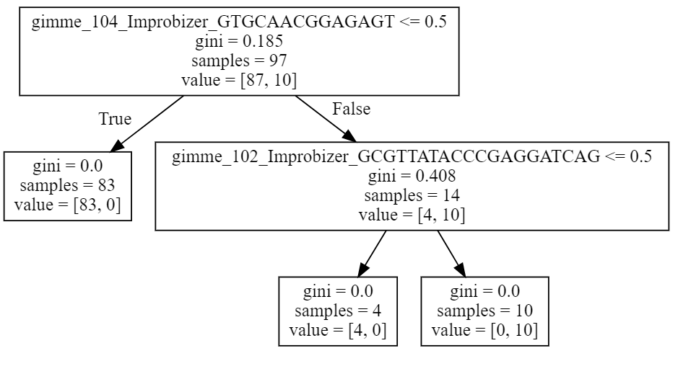
Decision tree based on Right most motifs
true positives: 1
false positives: 0
true negatives: 45
false negatives: 2
true positive to false positive ratio: N/A divide by 0
true negative to false negative ratio: 22.5
Sensitivity: 0.33333333
Specificity: 1.0
Accuracy: 0.9583

Slide 4
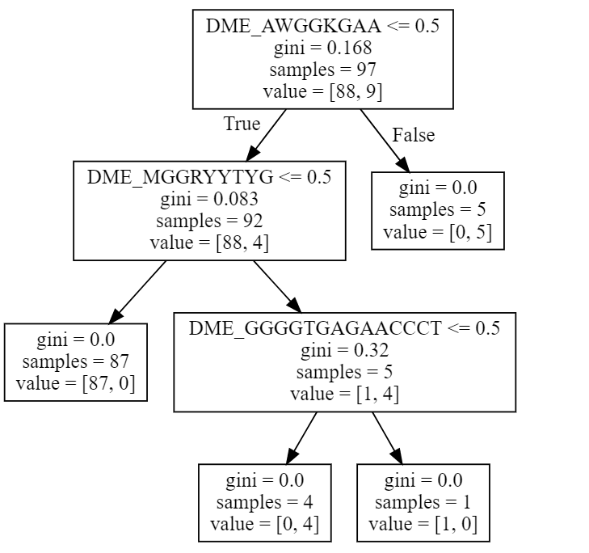
Decision tree based on bottom most motifs
true positives: 1
false positives: 1
true negatives: 43
false negatives: 3
true positive to false positive ratio: 1.0
true negative to false negative ratio: 14.333333333333334
Sensitivity: 0.25
Specificity: 0.977272
Accuracy: 0.916

Slide 5
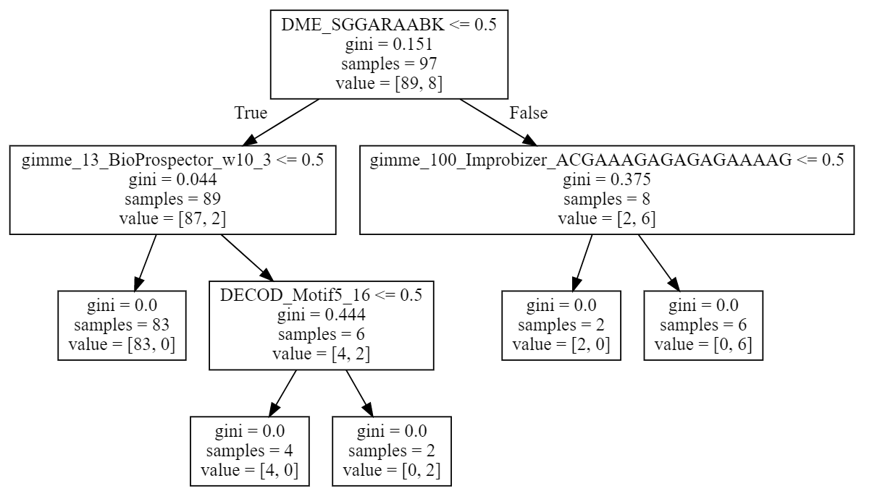
Decision tree based on motifs more common in foreground
true positives: 3
false positives: 0
true negatives: 43
false negatives: 2
true positive to false positive ratio: N/A divide by 0
true negative to false negative ratio: 21.5
Sensitivity: 0.6
Specificity: 1.0
Accuracy: 0.958

Slide 6
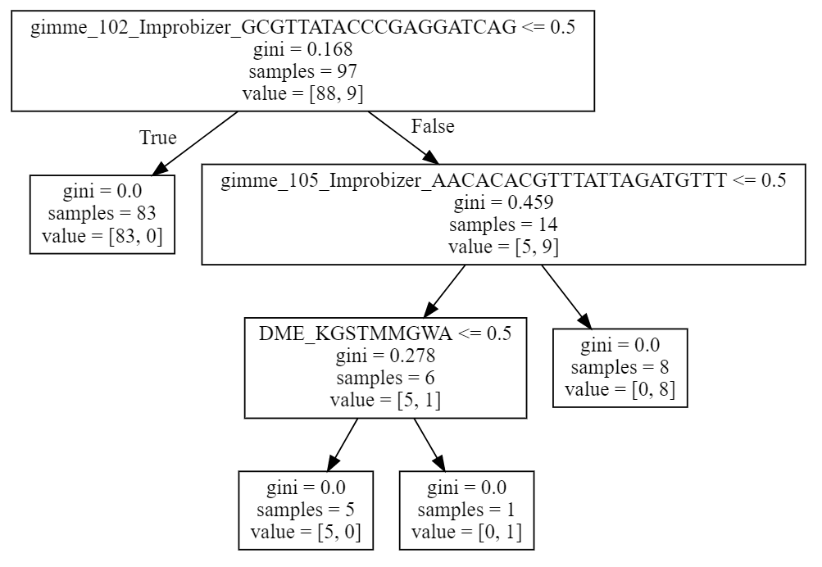
Decision tree based on bottom and right
true positives: 3
false positives: 0
true negatives: 44
false negatives: 1
true positive to false positive ratio: N/A divide by 0
true negative to false negative ratio: 44.0
Sensitivity: 0.75
Specificity: 1.0
Accuracy: 0.979

Slide 7
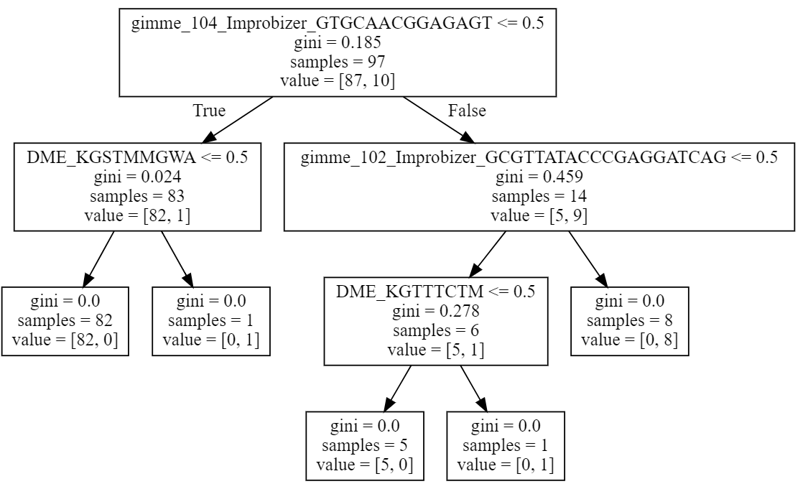
Decision tree based on LASSO feature selection
?
true positives: 3
false positives: 1
true negatives: 44
false negatives: 0
true negative to false negative ratio: N/A divide by 0
true positive to false positive ratio: 3.0
Sensitivity: 1.0
Specificity: 0.977
Accuracy: 0.979

